Slide 1
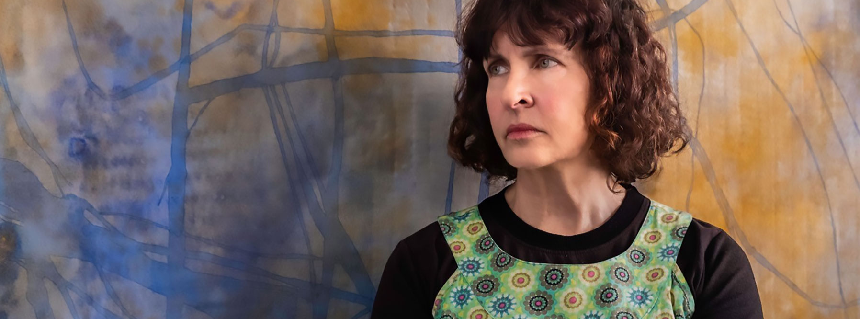
CASE STUDY
JUDY WATSON

Slide 2
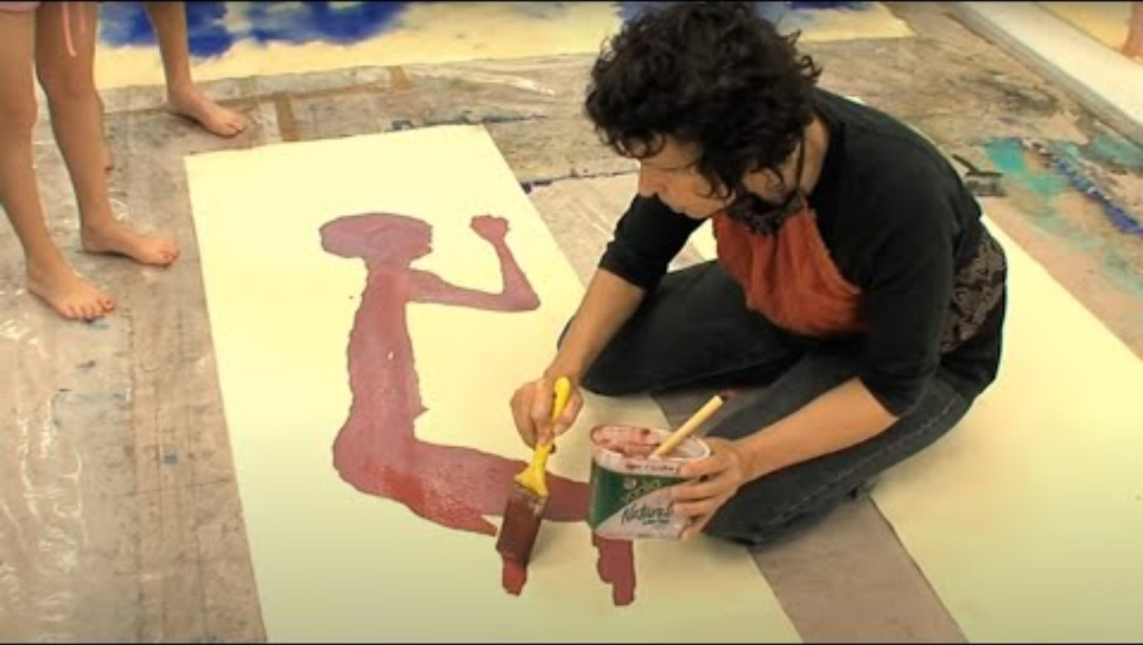
Artist Interview with Judy Watson

Slide 3
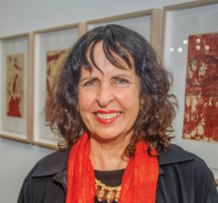
JUDY WATSON
Judy Watson's artistic practice is deeply rooted in her personal history, heritage, and sense of place. As a woman of mixed Indigenous and non-Indigenous descent, she explores themes of identity, memory, and history, often drawing from her childhood experiences in Queensland.
My work is an affirmation of my identity, ancestral links and connection to Country. Being with family and talking to my Grandmother has been a primary inspiration. I absorbed her memories, gained an insight into her life and the way she saw the land, was shown bush foods and sites. This is my major research as an Indigenous visual artist. The strength of these experiences sustains me and is the touchstone for my work. – Judy Watson

Slide 4
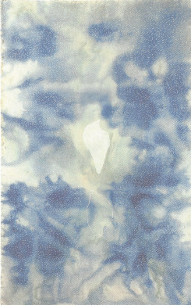
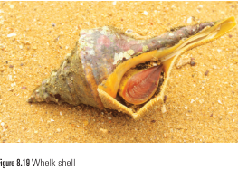
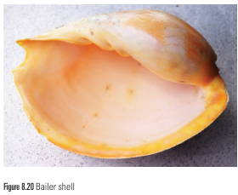
Watson's work is characterized by a strong connection to water, which she sees as a conduit for energy and creativity. She incorporates Indigenous symbols and objects into her art, reflecting her upbringing and connection to her heritage.
While living in France, Watson had a significant dream about the bailer and conch shells. As Watson recalls: I dreamt that I saw a waterspout (where the water is swept up in the air) from the beach. This one was like a clear glass rectangle. All of a sudden it turned, tearing up the beach towards us. We scattered as it tore right through the brick walls of the house I was living in. In its wake, it left two large white shells, a bailer and a conch, in a deep trench in the sand. It felt like these shells had been sucked up from the bottom of the ocean. They are symbolic, images of resistance and survival. – JUDY WATSON
The dream was a source of inspiration. Within waterspout, the shapes of whelk and bailer shells are central and steadfast among the swirling torrent of the violent waterspout. Deeply personal metaphors appear throughout Watson’s work. They echo the joys and traumas of her ancestors and powerfully resonate with other Indigenous peoples. Thus, her personal metaphors are also metonymy. The conch and whelk shells are a metaphor for the male, traditionally used by men as a warning, a signal for survival and to gather together. Men would blow into a conch or whelk shell and the sound could be heard over great distances.
Judy Watson, Waterspout, 1996

Slide 5
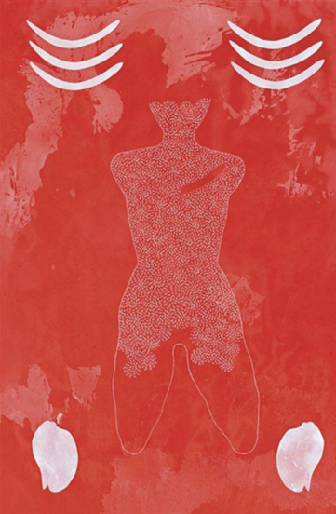
Through her art, Watson also addresses political and historical issues, particularly the impact of colonization on Indigenous peoples. Her Watson's art is not only a means of personal expression but also a platform for commentary on broader social issues.
Judy Watson, a history of violence, 2010
Watson’s work "a history of violence" is a poignant example, depicting the story of her great-great-grandmother who survived a violent attack.
The painting uses the bailer shell as a metaphor for the female. The central figure in the painting is a young woman, depicted with swirling lines reminiscent of the central spiral of the bailer shell, symbolizing life force. The figure has no arms or legs below the knee, and the texture of the painting creates a textured pattern that gives shape to the figure. There are also six curved thick lines above the figure, three on either side, and can be read as representing rib bones or boomerangs.
The monochromatic red painting with lighter red stains and white markings represents the impact of colonization on Indigenous peoples in Australia, with the negative space in the chest symbolizing intergenerational trauma.
Judy Watson, a history of violence, 2010

Slide 6
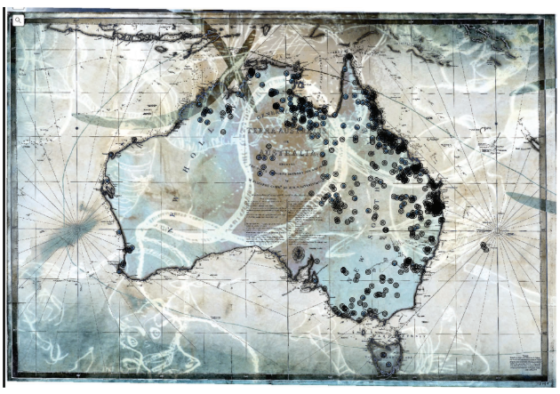
Judy Watson, the names of places, 2017
Judy Watson collaborated with others to create "the names of places," an interactive web-based project that maps sites throughout Australia where Indigenous people were massacred.
The project provides details from 19th and 20th-century handwritten documents outlining the circumstances and casualties of these massacres. It invites viewers to contribute information to increase awareness of Indigenous massacres in Australia, highlighting a hidden history and prompting viewer response.
Judy Watson, the names of places, 2017

Slide 7
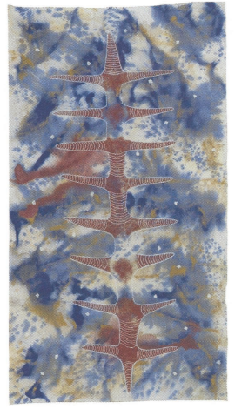
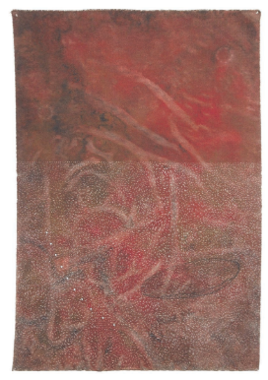
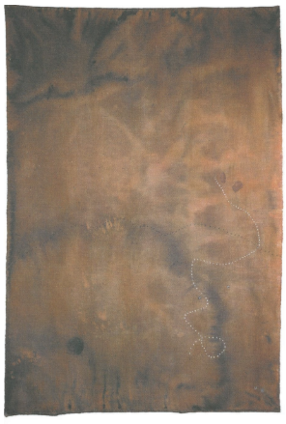
Influenced by authors like Judith Wright and E.E. Cummings, Watson's work often combines visual and written elements, creating a poetic and reflective quality. She invites viewers to engage with her art on a personal level, encouraging them to consider their own identities and place in the world. Overall, Judy Watson's artistic practice is a rich tapestry of personal narrative, cultural heritage, and social commentary.
spine, 1997
Listening springs, 1991
Low tide walk, 1991

Slide 8
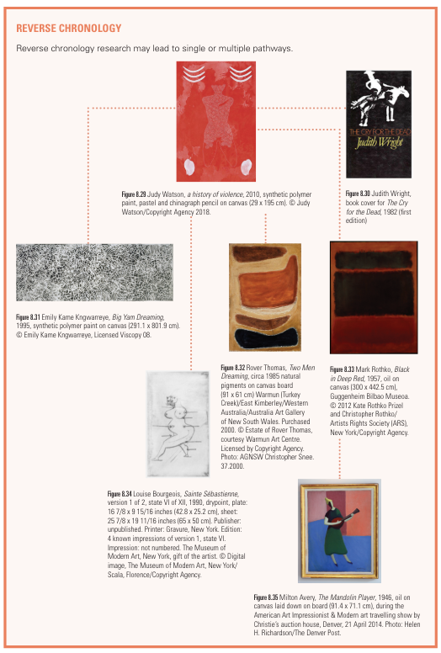
Review questions:
1. How does Judy Watson's artwork, particularly "a history of violence" and "the names of places," challenge and expand your understanding of Australian history and its impact on Indigenous peoples?
2. Choose an artwork by Judy Watson.
Analyse this artwork through the formal context to interpret formal visual art elements and principles
Analyse the application of materials and techniques, the stylistic qualities relative to historical periods or iconology, and how these contribute to engagement, communication and meaning.

Slide 9

ACTIVITY
Think of your own history, including previous generations, if possible. There is likely to be both joy and pain in recollecting past circumstances. What objects, images, figures and elements from your life can you use as metaphors for your own history? Some of the imagery may come from previous generations, some may be objects that you interact with every day.
Using a making process such as drawing, photography, painting or printmaking, arrange the objects so they interact with each other. Perhaps some of the objects or images can be imbedded within other objects as Watson has done in a history of violence with the figure and the central spiral of the bailer shell.
Experiment by taking one element of an object or image and repeat it so that you create a pattern or texture.
How does your own story speak to a larger audience?

